Slide 1
Object-Oriented Software Engineering
Practical Software Development using UML and Java
Chapter 8:
Modelling Interactions and Behaviour

Slide 2
8.3 Activity Diagrams
  Depicts high-level business processes, including data flow, or to model the logic of complex logic within a system
  An activity diagram
    Can be used to understand the flow of work that an object or component performs.
    Can also be used to visualize the interrelation and interaction between different use cases.
    Is most often associated with several classes.
  One of the strengths of activity diagrams is the representation of concurrent activities.
© Lethbridge/Laganière 2005
Chapter 8: Modelling Interactions and Behaviour

Slide 3
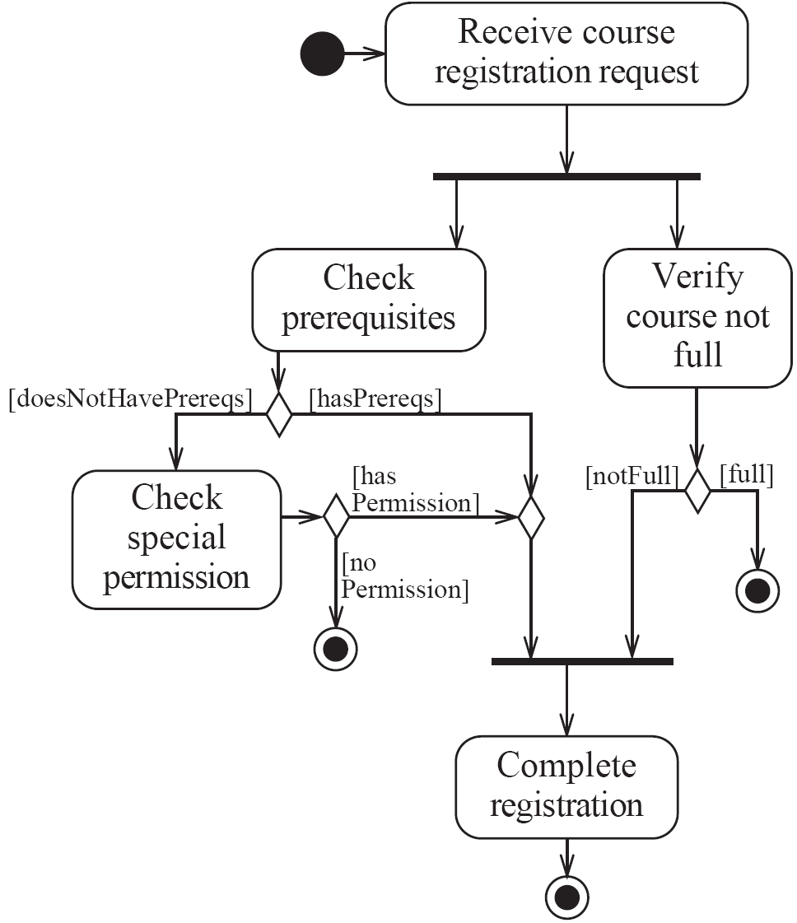
Activity diagrams – an example
© Lethbridge/Laganière 2005
Chapter 8: Modelling Interactions and Behaviour

Slide 4
Representing concurrency
  Concurrency is shown using forks, joins and rendezvous.
    A fork has one incoming transition and multiple outgoing transitions.
      The execution splits into two concurrent threads.
    A rendezvous has multiple incoming and multiple outgoing transitions.
      Once all the incoming transitions occur all the outgoing transitions may occur.
© Lethbridge/Laganière 2005
Chapter 8: Modelling Interactions and Behaviour

Slide 5
Representing concurrency
    A join has multiple incoming transitions and one outgoing transition.
      The outgoing transition will be taken when all incoming transitions have occurred.
      The incoming transitions must be triggered in separate threads.
      If one incoming transition occurs, a wait condition occurs at the join until the other transitions occur.
© Lethbridge/Laganière 2005
Chapter 8: Modelling Interactions and Behaviour

Slide 6
Swimlanes
Activity diagrams are most often associated with several classes.
  The partition of activities among the existing classes can be explicitly shown using swimlanes.
© Lethbridge/Laganière 2005
Chapter 8: Modelling Interactions and Behaviour

Slide 7
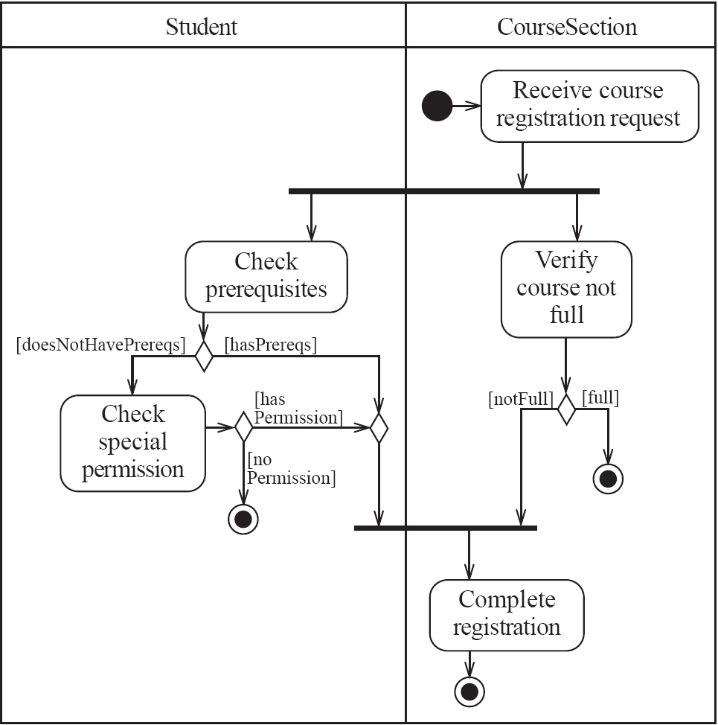
Activity diagrams – an example with swimlanes
© Lethbridge/Laganière 2005
Chapter 8: Modelling Interactions and Behaviour

Slide 8
8.1 Interaction Diagrams
Interaction diagrams are used to model the dynamic aspects of a software system
  They help you to visualize how the system runs.
  An interaction diagram is often built from a use case and a class diagram.
    The objective is to show how a set of objects accomplish the required interactions with an actor.
© Lethbridge/Laganière 2005
Chapter 8: Modelling Interactions and Behaviour
Notes:
http://www.smartdraw.com/tutorials/software/uml/tutorial_01.htm

Slide 9
Interactions and messages
  Interaction diagrams show how a set of actors and objects communicate with each other to perform:
    The steps of a use case, or
    The steps of some other piece of functionality.
  The set of steps, taken together, is called an interaction.
  Interaction diagrams can show several different types of communication.
    E.g. method calls, messages send over the network
    These are all referred to as messages.
© Lethbridge/Laganière 2005
Chapter 8: Modelling Interactions and Behaviour

Slide 10
Elements found in interaction diagrams
  Instances of classes
    Shown as boxes with the class and object identifier underlined
    Including 3-tier stereotype indication
  Actors
    Use the stick-person symbol as in use case diagrams
  Messages
    Shown as arrows from actor to object, or from object to object
© Lethbridge/Laganière 2005
Chapter 8: Modelling Interactions and Behaviour

Slide 11
Creating interaction diagrams
You should develop a class diagram and a use case model before starting to create an interaction diagram.
  There are two kinds of interaction diagrams:
    Sequence diagrams
    Communication diagrams
© Lethbridge/Laganière 2005
Chapter 8: Modelling Interactions and Behaviour

Slide 12
Communication diagrams
Communication diagrams emphasise how the objects collaborate in order to realize an interaction
  A communication diagram is a graph with the objects as the vertices.
  Communication links are added between objects
  Messages are attached to these links.
    Shown as arrows labelled with the message name
  Time ordering is indicated by prefixing the message with some numbering scheme.
© Lethbridge/Laganière 2005
Chapter 8: Modelling Interactions and Behaviour

Slide 13
Communication diagrams – an example
© Lethbridge/Laganière 2005
Chapter 8: Modelling Interactions and Behaviour

Slide 14
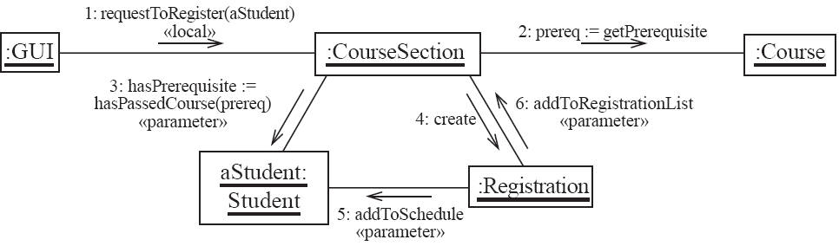
Communication diagrams – same example, more details
© Lethbridge/Laganière 2005
Chapter 8: Modelling Interactions and Behaviour

Slide 15
Communication links
  A communication link can exist between two objects whenever it is possible for one object to send a message to the other one.
  Several situations can make this message exchange possible:
    1. The classes of the two objects have an association between them.
      This is the most common case.
      If all messages are sent in the same direction, then probably the association can be made unidirectional.
© Lethbridge/Laganière 2005
Chapter 8: Modelling Interactions and Behaviour

Slide 16
Other communication links
    2. The receiving object is stored in a local variable of the sending method.
      This often happens when the object is created in the sending method or when some computation returns an object .
      The stereotype to be used is «local» or [L].
    3. A reference to the receiving object has been received as a parameter of the sending method.
      The stereotype is «parameter» or [P].
© Lethbridge/Laganière 2005
Chapter 8: Modelling Interactions and Behaviour

Slide 17
Other communication links
    4. The receiving object is global.
      This is the case when a reference to an object can be obtained using a static method.
      The stereotype «global», or a [G] symbol is used in this case.
    5. The objects communicate over a network.
      We suggest to write «network».
© Lethbridge/Laganière 2005
Chapter 8: Modelling Interactions and Behaviour
Notes:
Add 3 layer example in RUP book p. 341 – use this as an approach to a powerful communication diagram

Slide 18
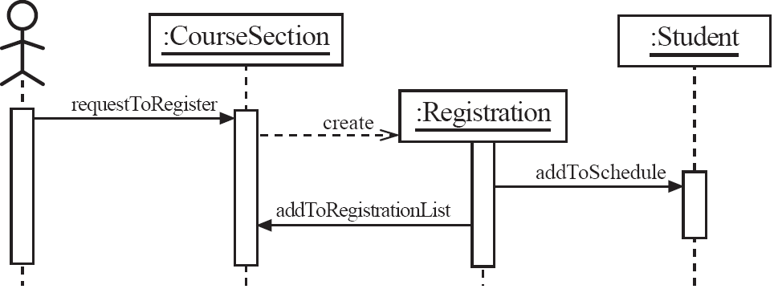
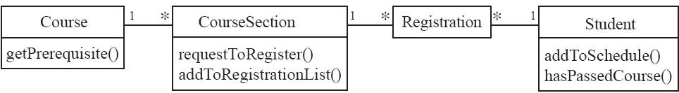
Sequence diagrams – an example
© Lethbridge/Laganière 2005
Chapter 8: Modelling Interactions and Behaviour
Notes:
http://www.agilemodeling.com/style/

Slide 19
Sequence diagrams
A sequence diagram shows the sequence of messages exchanged by the set of objects performing a certain task
  The objects are arranged horizontally across the diagram.
  An actor that initiates the interaction is often shown on the left.
  The vertical dimension represents time.
  A vertical line, called a lifeline, is attached to each object or actor.
  The lifeline becomes a broad box, called an activation box during the live activation period.
  A message is represented as an arrow between activation boxes of the sender and receiver.
    A message is labelled and can have an argument list and a return value.
© Lethbridge/Laganière 2005
Chapter 8: Modelling Interactions and Behaviour
Notes:
Add sequence diagram example in UML distilled p. 104

Slide 20
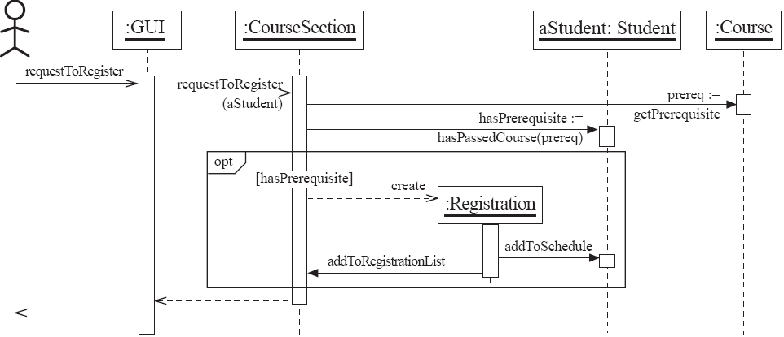
Sequence diagrams – same example, more details
© Lethbridge/Laganière 2005
Chapter 8: Modelling Interactions and Behaviour

Slide 21
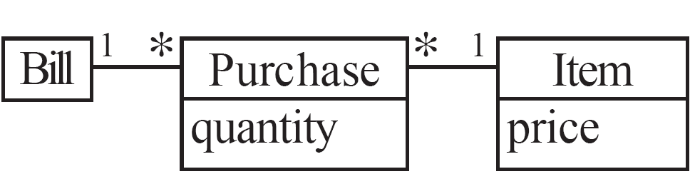
Sequence diagrams – an example with replicated messages
  An iteration over objects is indicated by an asterisk preceding the message name
© Lethbridge/Laganière 2005
Chapter 8: Modelling Interactions and Behaviour

Slide 22
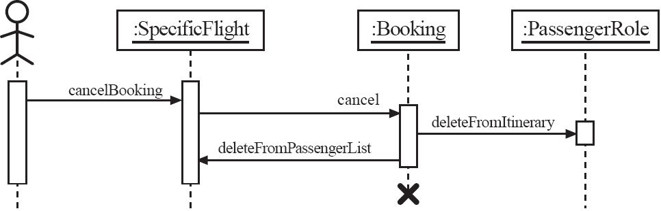
Sequence diagrams – an example with object deletion
  http://www.agilemodeling.com/style/sequenceDiagram.htm
© Lethbridge/Laganière 2005
Chapter 8: Modelling Interactions and Behaviour
Notes:
http://www.agilemodeling.com/style/sequenceDiagram.htm

Slide 23
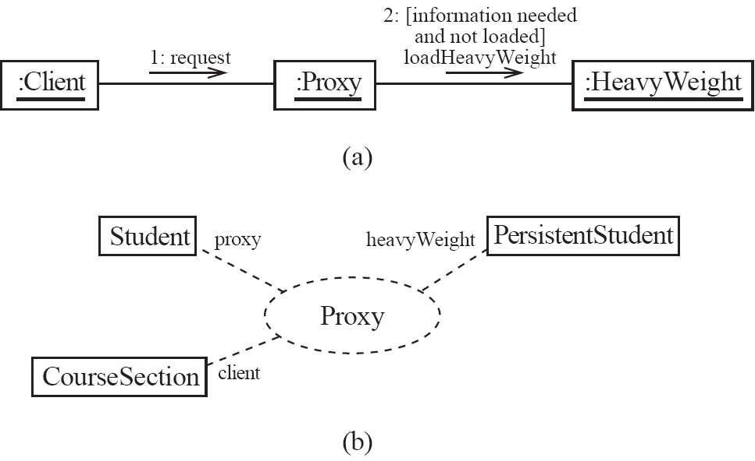
Communication diagrams and patterns
A communication diagram can be used to represent aspects of a design pattern
© Lethbridge/Laganière 2005
Chapter 8: Modelling Interactions and Behaviour

Slide 24
8.4 Implementing Classes Based on Interaction and State Diagrams
  You should use these diagrams for the parts of your system that you find most complex.
    I.e. not for every class
  Interaction, activity and state diagrams help you create a correct implementation.
  This is particularly true when behaviour is distributed across several use cases.
    E.g. a state diagram is useful when different conditions cause instances to respond differently to the same event.
© Lethbridge/Laganière 2005
Chapter 8: Modelling Interactions and Behaviour

Slide 25
Example: The CourseSection class
States:
  ‘Planned’:
    closedOrCancelled == false && open == false
  ‘Cancelled’:
    closedOrCancelled == true &&
    registrationList.size() == 0
  ‘Closed’ (course section is too full, or being taught):
    closedOrCancelled == true &&
    registrationList.size() > 0
© Lethbridge/Laganière 2005
Chapter 8: Modelling Interactions and Behaviour

Slide 26
Example: The CourseSection class
States:
  ‘Open’ (accepting registrations):
    open == true
  ‘NotEnoughStudents’ (substate of ‘Open’):
    open == true &&
    registrationList.size() < course.getMinimum()
  ‘EnoughStudents’ (substate of ‘Open’):
    open == true &&
    registrationList.size() >= course.getMinimum()
© Lethbridge/Laganière 2005
Chapter 8: Modelling Interactions and Behaviour

Slide 27
Example: The CourseSection class
Class diagram
© Lethbridge/Laganière 2005
Chapter 8: Modelling Interactions and Behaviour

Slide 28
Example: The CourseSection class
public class CourseSection
{
// The many-1 abstraction-occurrence association (Figure 8.2)
private Course course;
// The 1-many association to class Registration (Figure 8.2)
private List registrationList;
// The following are present only to determine the state
// (as in Figure 8.19). The initial state is 'Planned‘
private boolean open = false;
private boolean closedOrCanceled = false;
© Lethbridge/Laganière 2005
Chapter 8: Modelling Interactions and Behaviour

Slide 29
Example: The CourseSection class
public CourseSection(Course course)
{
this.course = course;
registrationList = new LinkedList();
}
public void openRegistration()
{
if(!closedOrCanceled) // must be in 'Planned' state
{
open = true; // to 'OpenNotEnoughStudents' state
}
}
© Lethbridge/Laganière 2005
Chapter 8: Modelling Interactions and Behaviour

Slide 30
Example: The CourseSection class
public void closeRegistration()
{
// to 'Canceled' or 'Closed' state
open = false;
closedOrCanceled = true;
if (registrationList.size() < course.getMinimum())
{
unregisterStudents(); // to 'Canceled' state
}
}
public void cancel()
{
// to 'Canceled' state
open = false;
closedOrCanceled = true;
unregisterStudents();
}
© Lethbridge/Laganière 2005
Chapter 8: Modelling Interactions and Behaviour

Slide 31
Example: The CourseSection class
public void requestToRegister(Student student)
{
if (open) // must be in one of the two 'Open' states
{
// The interaction specified in the sequence diagram of Figure 8.4
Course prereq = course.getPrerequisite();
if (student.hasPassedCourse(prereq))
{
// Indirectly calls addToRegistrationList
new Registration(this, student);
}
// Check for automatic transition to 'Closed' state
if (registrationList.size() >= course.getMaximum())
{
// to 'Closed' state
open = false;
closedOrCanceled = true;
}
}
}
© Lethbridge/Laganière 2005
Chapter 8: Modelling Interactions and Behaviour

Slide 32
Example: The CourseSection class
// Private method to remove all registrations
// Activity associated with 'Canceled' state.
private void unregisterStudents()
{
Iterator it = registrationList.iterator();
while (it.hasNext())
{
Registration r = (Registration)it.next();
r.unregisterStudent();
it.remove();
}
}
// Called within this package only, by the constructor of
// Registration to ensure the link is bi-directional
void addToRegistrationList(Registration newRegistration)
{
registrationList.add(newRegistration);
}
}
© Lethbridge/Laganière 2005
Chapter 8: Modelling Interactions and Behaviour

Slide 33
8.5 Difficulties and Risks in Modelling Interactions and Behaviour
Dynamic modelling is a difficult skill
  In a large system there are a very large number of possible paths a system can take.
  It is hard to choose the classes to which to allocate each behaviour:
    Ensure that skilled developers lead the process, and ensure that all aspects of your models are properly reviewed.
    Work iteratively:
      Develop initial class diagrams, use cases, responsibilities, interaction diagrams and state diagrams;
      Then go back and verify that all of these are consistent, modifying them as necessary.
    Drawing different diagrams that capture related, but distinct, information will often highlight problems.
© Lethbridge/Laganière 2005
Chapter 8: Modelling Interactions and Behaviour

